Slide 1
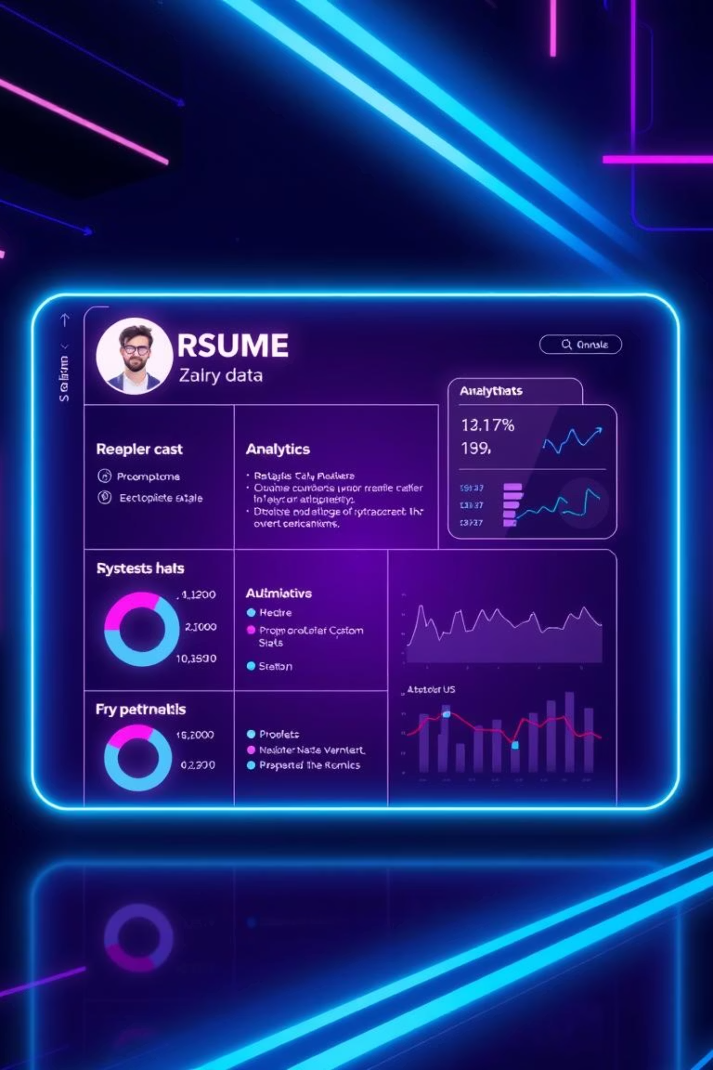
AI Resume Analyzer
Hello everyone! Today, I'll present my project: the AI Resume Analyzer, an AI-powered tool. It aims to improve resume screening through NLP and semantic scoring.

Slide 2

Addressing Recruitment Challenges
Recruiters face significant challenges. Manual resume screening is inefficient and prone to bias. This project offers a solution by automating and enhancing the process.
1
Resume Parsing and Analysis
2
Contextual Scoring
3
Personalised Suggestions
Automatically extract and analyse key information from resumes.
Score resumes based on content and contextual relevance.
Provide tailored feedback for resume improvement.

Slide 3


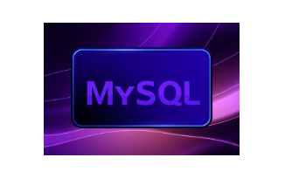
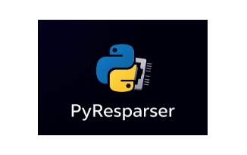
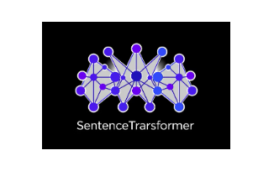





Technology Stack: Powering the Analyzer
Our AI Resume Analyzer leverages a robust set of technologies. These tools seamlessly integrate to handle parsing, scoring, simulation, and visualization of the recruitment process.
Python
Streamlit
MySQL
Core programming language for backend logic.
Used for intuitive and interactive web user interface.
Reliable database for efficient data storage and retrieval.
PyResparser
SentenceTransformer
Specialised tool for accurate resume parsing.
Enables advanced semantic NLP scoring.

Slide 4
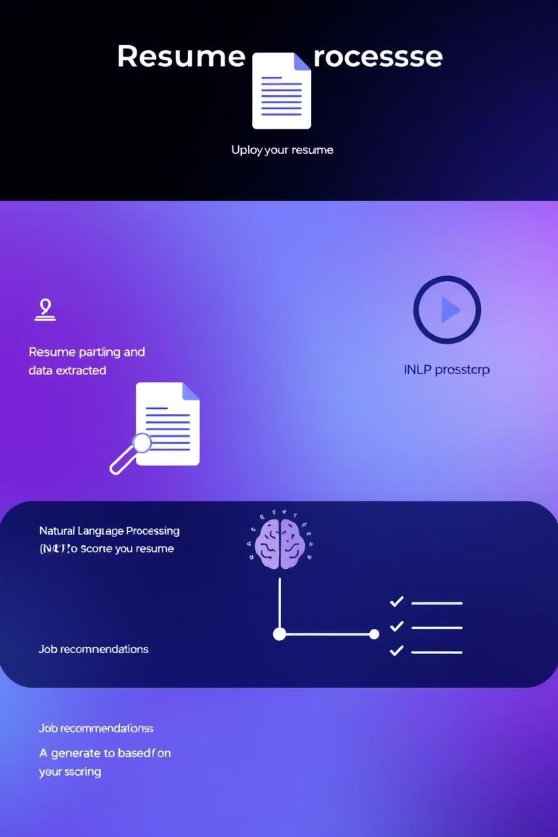




System Architecture: Seamless Workflow
The system architecture ensures a smooth and efficient resume analysis process. Each step is designed for optimal performance and accuracy.
Resume Upload
Candidates upload resumes via Streamlit interface.
Parsing
PyResparser extracts key information automatically.
NLP Scoring
SentenceTransformer performs semantic analysis.
Skill Gap & Recommendations
Identifies gaps and suggests improvements for candidates.

Slide 5
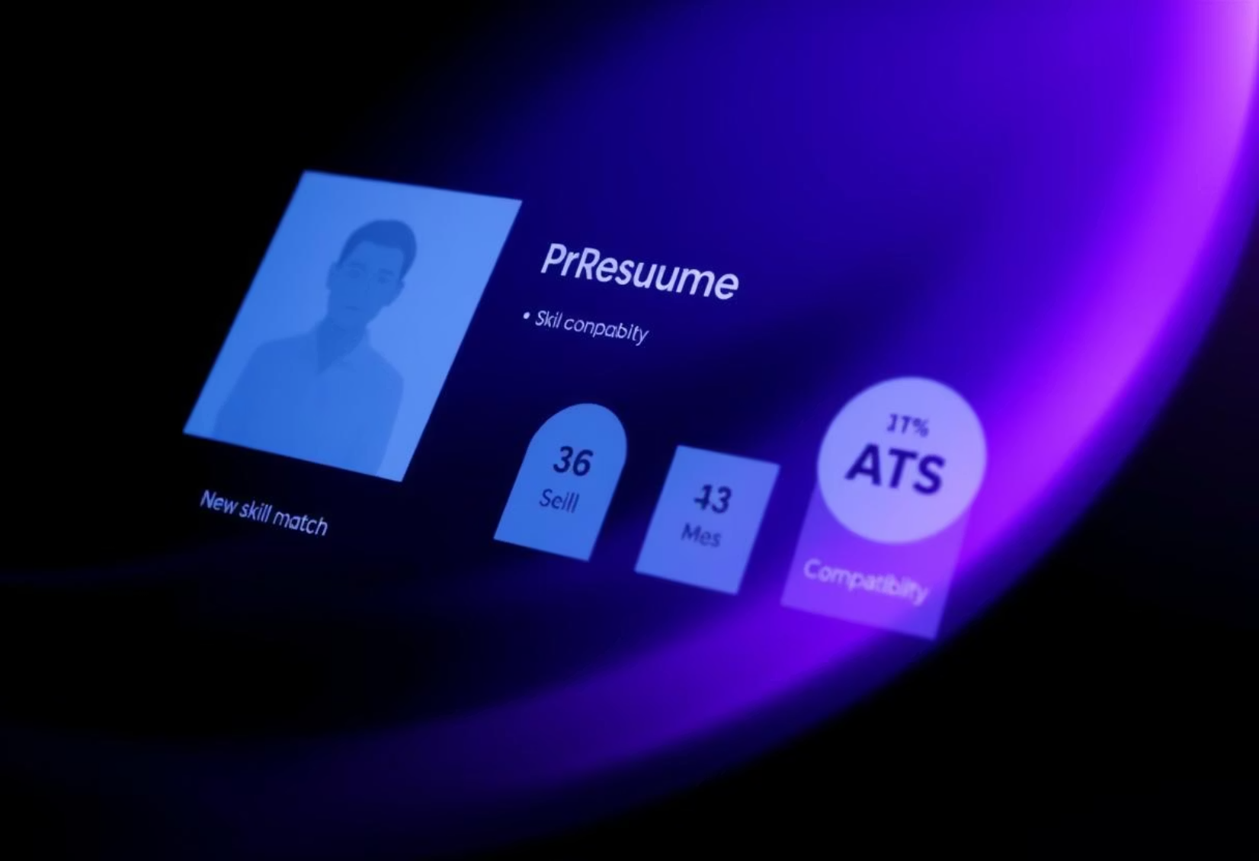
Integrated Candidate Evaluation
Our system evaluates each applicant comprehensively. We simulate how top resumes are shortlisted, providing clear insights into the selection process.
Resume Score
Quantitative assessment of overall resume quality.
ATS Compatibility
Ensures resumes pass Applicant Tracking Systems.
Skills Matching
Evaluates relevance of skills to job description.

Slide 6
Project Timeline Overview
This project was executed methodically, week by week, to ensure comprehensive development and feature integration. Each phase built upon the last.
W1: Setup, PyResparser, keyword scoring
1
2
W2: NLP semantic scoring (SentenceTransformer)
W3: Intelligent suggestions (Coursera/Udemy, weak section finder)
3
4
W4: STAR guidance, ATS compatibility
W5: Benchmarking with peer resume
5

Slide 7
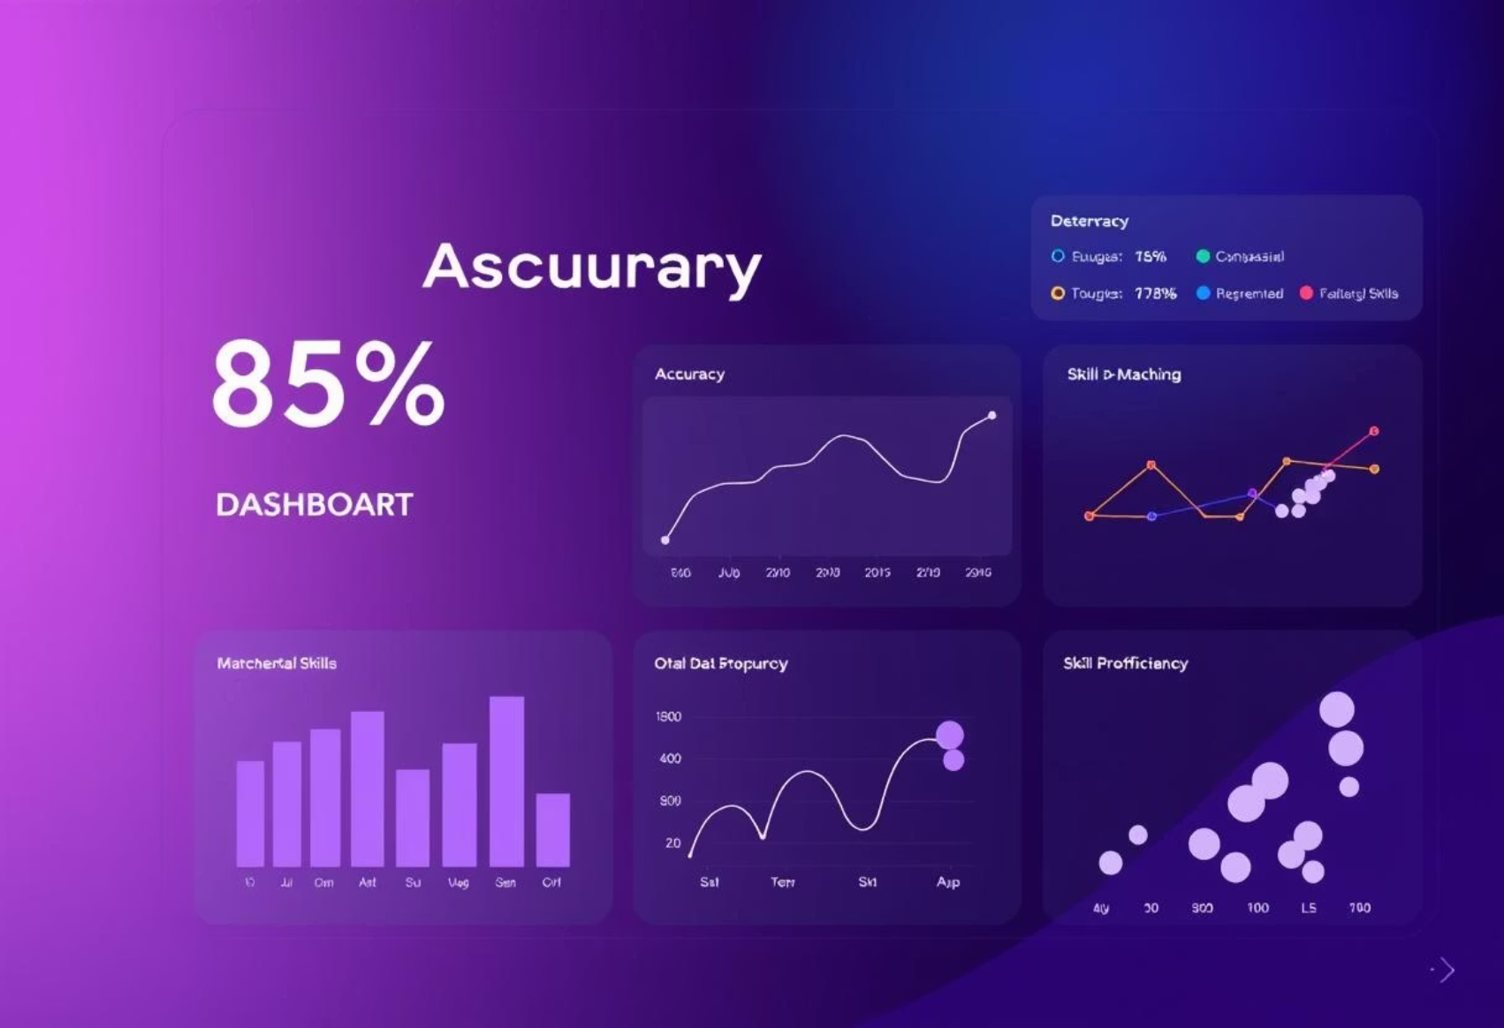
System Output and Key Results
The AI Resume Analyzer delivers actionable insights, significantly improving the recruitment process. Our results demonstrate high accuracy.
1
Resume Score (0-100)
Clear performance metric for candidates.
2
Highlighted Weaknesses
Identifies areas for improvement.
3
Suggested Improvements
Actionable advice for enhancing resume quality.
4
Semantic Match
Measures alignment with job descriptions.
5
Admin Dashboard
Our system achieved up to 85% accuracy in matching resumes to job descriptions. This high level of precision significantly streamlines the hiring process.
Provides analytics for recruiters.

Slide 8
Conclusion & Key Learnings
The AI Resume Analyzer represents a significant leap in recruitment technology. It offers enhanced efficiency and candidate quality.
1
2
3
4
Improved Recruitment
Personalized Feedback
AI Pipeline Integration
Semantic NLP
Leveraging AI for smarter hiring decisions.
Boosting candidate quality through tailored suggestions.
Successful end-to-end system development.
Advanced scoring for deeper insights.
5
Simulation & Data
Combining theory with real-world application.

